Slide 1
4.9 Multiple-Subscripted Arrays
Multiple subscripts
  a[ i ][ j ]
  Tables with rows and columns
  Specify row, then column
  “Array of arrays”
    a[0] is an array of 4 elements
    a[0][0] is the first element of that array
Column 0
Column 1
Column 2
Column 3
Row 0
a[ 0 ][ 0 ]
a[ 0 ][ 1 ]
a[ 0 ][ 2 ]
a[ 0 ][ 3 ]
Row 1
a[ 1 ][ 0 ]
a[ 1 ][ 1 ]
a[ 1 ][ 2 ]
a[ 1 ][ 3 ]
Row 2
a[ 2 ][ 0 ]
a[ 2 ][ 1 ]
a[ 2 ][ 2 ]
a[ 2 ][ 3 ]
Column subscript
Array name
Row subscript

Slide 2
4.9 Multiple-Subscripted Arrays
At the end, multidimensional arrays are just an abstraction for programmers, since the same results can be achieved with a simple array, by multiplying its indices:
(1) int arr [3][5]; // is equivalent to array (2)
(2) int arr [15]; // 3 * 5 = 15
The general correspondence is:
Array: arr [r_size][c_size] ➔ arr [r_size * c_size]
Element: arr [i][j] ➔ arr [i * c_size + j]

Slide 3
4.9 Multiple-Subscripted Arrays
To initialize
  Default of 0
  Initializers grouped by row in braces
  int b[ 2 ][ 2 ] = { { 1, 2 }, { 3, 4 } };
  int b[ 2 ][ 2 ] = { { 1 }, { 3, 4 } };
1 2
3 4
Row 0
Row 1
1 0
3 4

Slide 4
4.9 Multiple-Subscripted Arrays
Referenced like normal
      cout << b[ 0 ][ 1 ];
  Outputs 0
  Cannot reference using commas
      cout << b[ 0, 1 ];
    Syntax error
Function prototypes
  Must specify sizes of subscripts
    First subscript not necessary, as with single-scripted arrays
    In a way, passing an array as argument always loses a dimension. The reason behind is that, for historical reasons, arrays cannot be directly copied, and thus what is really passed is a pointer.
  e.g. void printArray( int [][ 3 ] );
1 0
3 4

Slide 5
fig04_22.cpp
(1 of 2)
1 // Fig. 4.22: fig04_22.cpp
2 // Initializing multidimensional arrays.
3 #include <iostream>
4
5 using std::cout;
6 using std::endl;
7
8 void printArray( int [][ 3 ] );
9
10 int main()
11 {
12 int array1[ 2 ][ 3 ] = { { 1, 2, 3 }, { 4, 5, 6 } };
13 int array2[ 2 ][ 3 ] = { 1, 2, 3, 4, 5 };
14 int array3[ 2 ][ 3 ] = { { 1, 2 }, { 4 } };
15
16 cout << "Values in array1 by row are:" << endl;
17 printArray( array1 );
18
19 cout << "Values in array2 by row are:" << endl;
20 printArray( array2 );
21
22 cout << "Values in array3 by row are:" << endl;
23 printArray( array3 );
24
25 return 0; // indicates successful termination
26
27 } // end main
Note the format of the prototype.
Note the various initialization styles. The elements in array2 are assigned to the first row and then the second.

Slide 6
fig04_22.cpp
(2 of 2) fig04_22.cpp output (1 of 1)
28
29 // function to output array with two rows and three columns
30 void printArray( int a[][ 3 ] )
31 {
32 for ( int i = 0; i < 2; i++ ) { // for each row
33
34 for ( int j = 0; j < 3; j++ ) // output column values
35 cout << a[ i ][ j ] << ' ';
36
37 cout << endl; // start new line of output
38
39 } // end outer for structure
40
41 } // end function printArray
For loops are often used to iterate through arrays. Nested loops are helpful with multiple-subscripted arrays.
Values in array1 by row are:
1 2 3
4 5 6
Values in array2 by row are:
1 2 3
4 5 0
Values in array3 by row are:
1 2 0
4 0 0

Slide 7
4.9 Multiple-Subscripted Arrays
Next: program showing initialization
  After, program to keep track of students grades
  Multiple-subscripted array (table)
  Rows are students
  Columns are grades
Quiz1
Quiz2
Student0
95 85
89 80
Student1

Slide 8
fig04_23.cpp
(1 of 6)
1 // Fig. 4.23: fig04_23.cpp
2 // Double-subscripted array example.
3 #include <iostream>
4
5 using std::cout;
6 using std::endl;
7 using std::fixed;
8 using std::left;
9
10 #include <iomanip>
11
12 using std::setw;
13 using std::setprecision;
14
15 const int students = 3; // number of students
16 const int exams = 4; // number of exams
17
18 // function prototypes
19 int minimum( int [][ exams ], int, int );
20 int maximum( int [][ exams ], int, int );
21 double average( int [], int );
22 void printArray( int [][ exams ], int, int );
23

Slide 9
fig04_23.cpp
(2 of 6)
24 int main()
25 {
26 // initialize student grades for three students (rows)
27 int studentGrades[ students ][ exams ] =
28 { { 77, 68, 86, 73 },
29 { 96, 87, 89, 78 },
30 { 70, 90, 86, 81 } };
31
32 // output array studentGrades
33 cout << "The array is:\n";
34 printArray( studentGrades, students, exams );
35
36 // determine smallest and largest grade values
37 cout << "\n\nLowest grade: "
38 << minimum( studentGrades, students, exams )
39 << "\nHighest grade: "
40 << maximum( studentGrades, students, exams ) << '\n';
41
42 cout << fixed << setprecision( 2 );
43

Slide 10
fig04_23.cpp
(3 of 6)
44 // calculate average grade for each student
45 for ( int person = 0; person < students; person++ )
46 cout << "The average grade for student " << person
47 << " is "
48 << average( studentGrades[ person ], exams )
49 << endl;
50
51 return 0; // indicates successful termination
52
53 } // end main
54
55 // find minimum grade
56 int minimum( int grades[][ exams ], int pupils, int tests )
57 {
58 int lowGrade = 100; // initialize to highest possible grade
59
60 for ( int i = 0; i < pupils; i++ )
61
62 for ( int j = 0; j < tests; j++ )
63
64 if ( grades[ i ][ j ] < lowGrade )
65 lowGrade = grades[ i ][ j ];
66
67 return lowGrade;
68
69 } // end function minimum
Determines the average for one student. We pass the array/row containing the student’s grades. Note that studentGrades[0] is itself an array.

Slide 11
fig04_23.cpp
(4 of 6)
70
71 // find maximum grade
72 int maximum( int grades[][ exams ], int pupils, int tests )
73 {
74 int highGrade = 0; // initialize to lowest possible grade
75
76 for ( int i = 0; i < pupils; i++ )
77
78 for ( int j = 0; j < tests; j++ )
79
80 if ( grades[ i ][ j ] > highGrade )
81 highGrade = grades[ i ][ j ];
82
83 return highGrade;
84
85 } // end function maximum
86

Slide 12
fig04_23.cpp
(5 of 6)
87 // determine average grade for particular student
88 double average( int setOfGrades[], int tests )
89 {
90 int total = 0;
91
92 // total all grades for one student
93 for ( int i = 0; i < tests; i++ )
94 total += setOfGrades[ i ];
95
96 return static_cast< double >( total ) / tests; // average
97
98 } // end function maximum

Slide 13
fig04_23.cpp
(6 of 6)
99
100 // Print the array
101 void printArray( int grades[][ exams ], int pupils, int tests )
102 {
103 // set left justification and output column heads
104 cout << left << " [0] [1] [2] [3]";
105
106 // output grades in tabular format
107 for ( int i = 0; i < pupils; i++ ) {
108
109 // output label for row
110 cout << "\nstudentGrades[" << i << "] ";
111
112 // output one grades for one student
113 for ( int j = 0; j < tests; j++ )
114 cout << setw( 5 ) << grades[ i ][ j ];
115
116 } // end outer for
117
118 } // end function printArray

Slide 14
fig04_23.cpp output (1 of 1)
The array is:
[0] [1] [2] [3]
studentGrades[0] 77 68 86 73
studentGrades[1] 96 87 89 78
studentGrades[2] 70 90 86 81
Lowest grade: 68
Highest grade: 96
The average grade for student 0 is 76.00
The average grade for student 1 is 87.50
The average grade for student 2 is 81.75

Slide 15
Vectors

Slide 16
7.11 Introduction to C++ Standard Library Class Template vector (Cont.)
vector elements can be obtained as an unmodifiable lvalue or as a modifiable lvalue
  Unmodifiable lvalue
    Expression that identifies an object in memory, but cannot be used to modify that object
  Modifiable lvalue
    Expression that identifies an object in memory, can be used to modify the object

Slide 17
7.11 Introduction to C++ Standard Library Class Template vector (Cont.)
vector member function at
  Provides access to individual elements
  Performs bounds checking
    Throws an exception when specified index is invalid
    Accessing with square brackets does not perform bounds checking

Slide 18
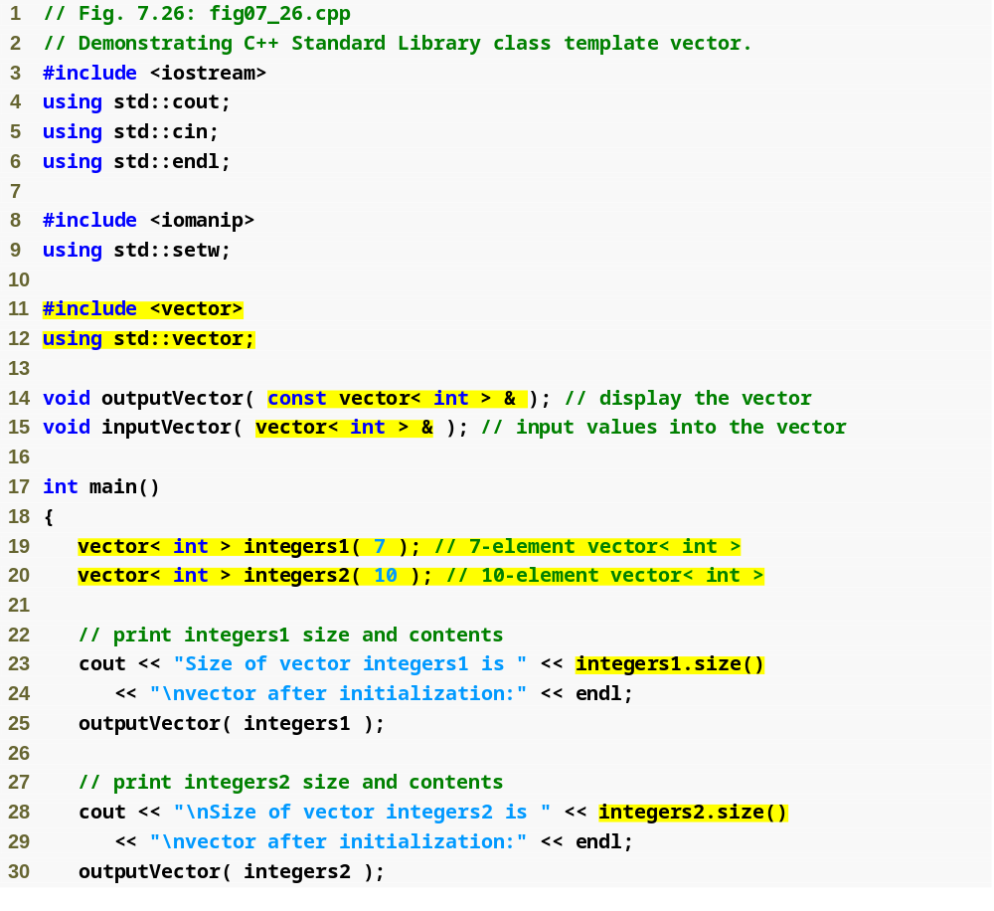
Outline
Using const prevents outputVector from modifying the vector passed to it
fig07_26.cpp
(1 of 6)
These vectors will store ints
Function size returns number of elements in the vector

Slide 19
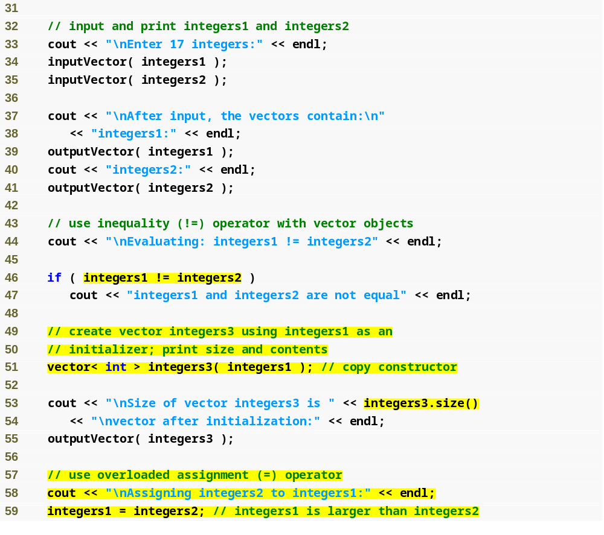
Outline
fig07_26.cpp
(2 of 6)
Comparing vectors using !=
Copying data from one vector to another
Assigning data from one vector to another

Slide 20
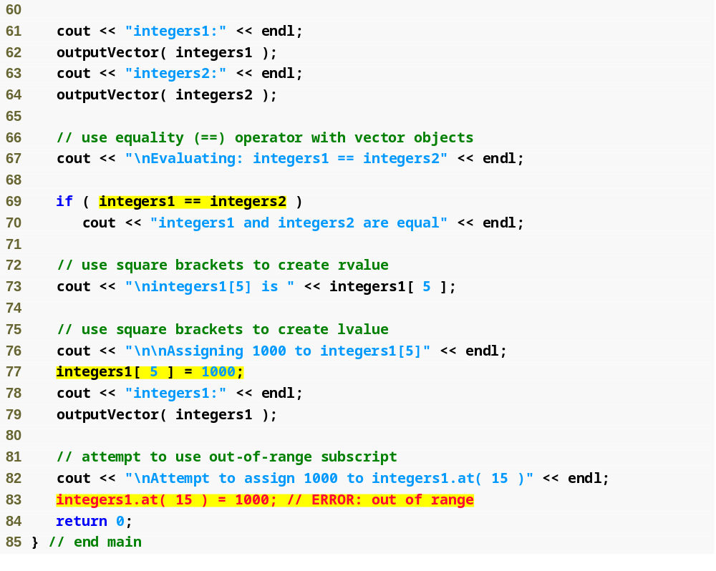
Outline
fig07_26.cpp
(3 of 6)
Comparing vectors using ==
Displaying a value in the vector
Updating a value in the vector
Function at provides bounds checking

Slide 21
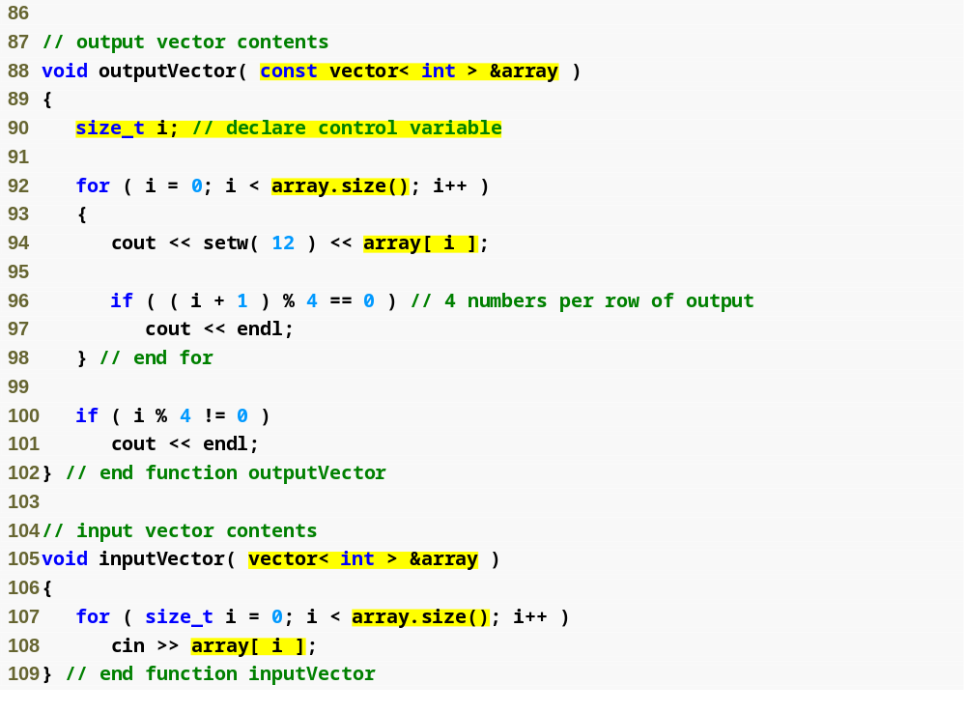
Outline
fig07_26.cpp
(4 of 6)
Display each vector element
Input vector values using cin

Slide 22
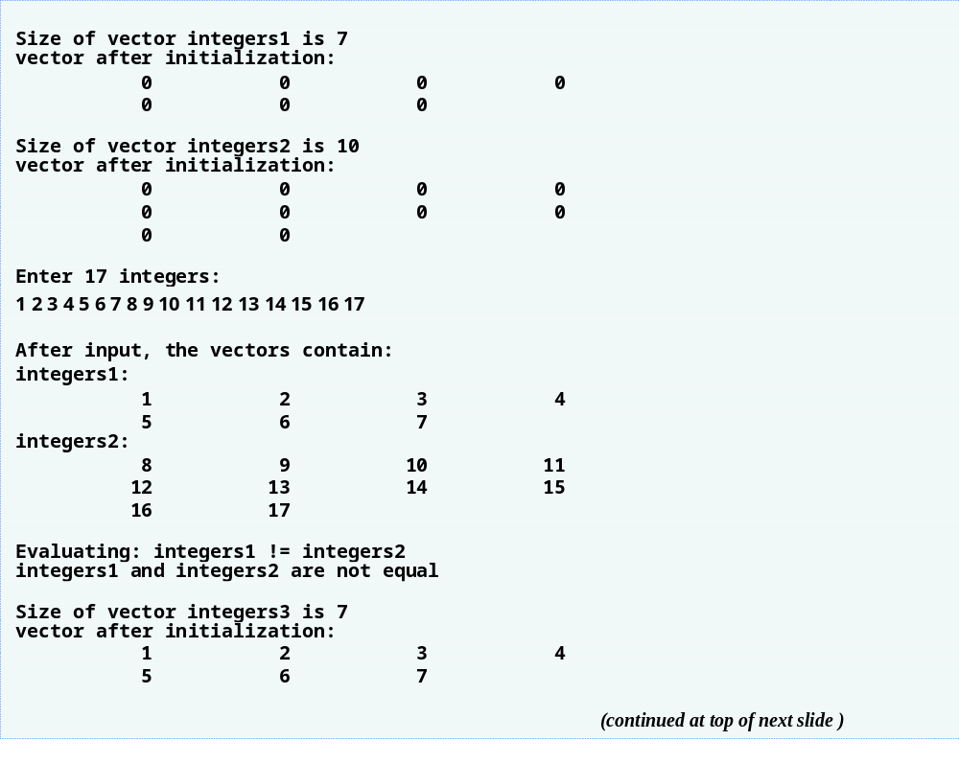
Outline
fig07_26.cpp
(5 of 6)

Slide 23
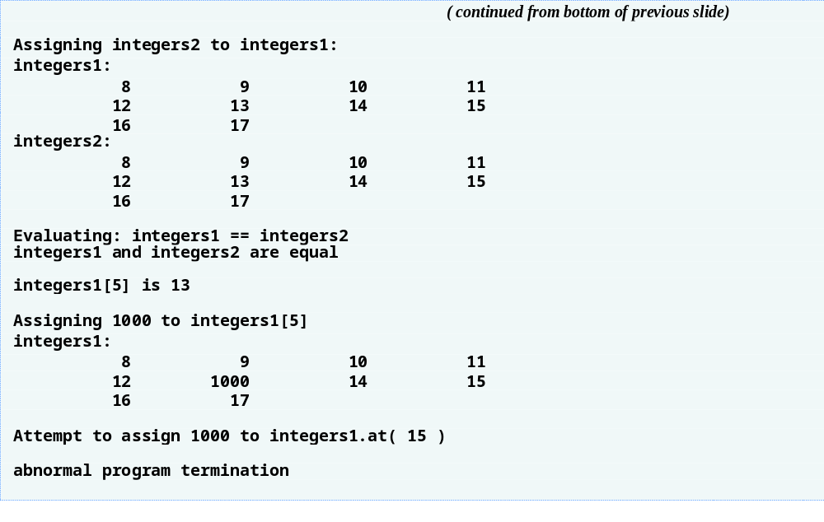
Outline
fig07_26.cpp
(6 of 6)
Call to function at with an invalid subscript terminates the program

